Slide 1

SDET Course
Design Patterns - Bridge

Slide 2
3 Types of Design Patterns
Creational
Singleton
Builder
Prototype
Factory Method
Abstract Factory
Structural
Adapter
Composite
Proxy
Flyweight
Bridge
Facade
Decorator
Behavioral
Strategy
Observer
Command
Memento
State
Template Method
Mediator
Chain of Responsibility
Interpreter
Visitor
Iterator

Slide 3
Agenda
Description
Diagram
Code sample (Java)
Use cases

Slide 4

Description
Introduction - A Universal Remote Control

Slide 5
Description
The Bridge design pattern is a structural pattern used in software engineering to decouple an abstraction from its implementation, allowing the two to vary independently. This pattern involves an interface which acts as a bridge between the abstraction and its implementation. By doing so, it enables the modification and extension of both the abstraction and its implementation without affecting each other. The key benefit of the Bridge pattern is increased flexibility in code structure and functionality. It's especially useful in scenarios where an application needs to support multiple platforms, or when it's expected to evolve both in terms of its core functionalities and the ways they are implemented. The pattern also helps in adhering to the principle of open/closed principle, one of the SOLID principles, making software easier to manage and extend over time.

Slide 6
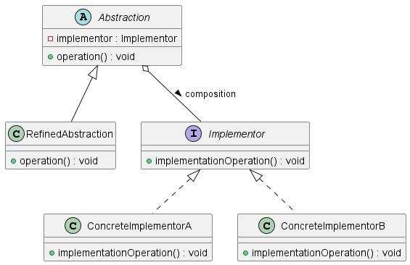
Class Diagram

Slide 7
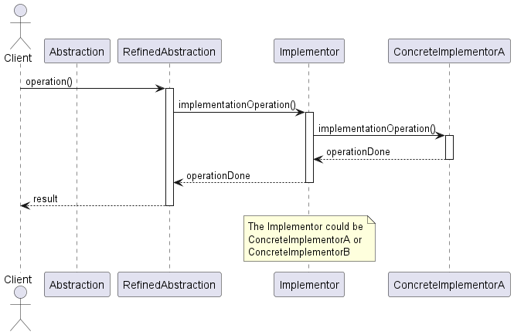
Sequence Diagram

Slide 8
Code Sample

Slide 9
Use cases
General
Cross Platform Applications
Database Persistence Layers (e.g Fillo)
In Test Automation
Appium
Test Reporting
Different Environments

Slide 10
Happy Coding

